Slide 1

Defending Against Phishing Attacks: A Cybersecurity Perspective

Slide 2




Introduction
Phishing attacks are in cybersecurity. They involve
attempts to obtain sensitive information. This presentation will
explore
strategies against phishing attacks.

Slide 3




Understanding Phishing
Phishing is a
attack
that relies on . Attackers often impersonate legitimate entities to trick victims into revealing
information.

Slide 4





Types of Phishing Attacks
Phishing attacks can take various forms,
including ,
Each type targets speciﬁc
organizations.
, and
.
within

Slide 5





Common Phishing Tactics
Phishers often use emails, attachments, and
websites to deceive victims. Understanding these tactics is crucial for and prevention.

Slide 6





Impact of Phishing Attacks
Phishing attacks can result in
,
damage to an organization's
, and
. The consequences of falling victim to phishing can be
.

Slide 7






Phishing Defense
Strategies
Implementing ,
, and
are essential defense
strategies against phishing. These measures can signiﬁcantly the
risk of successful attacks.

Slide 8





Security Awareness Training
Regular sessions can educate employees about and
phishing attempts. Building a
culture is key to strengthening defenses.

Slide 9




Email Filtering Solutions
Utilizing email ﬁltering tools can automatically detect and
suspicious emails. These solutions help in
phishing emails from reaching employees' inboxes.

Slide 10
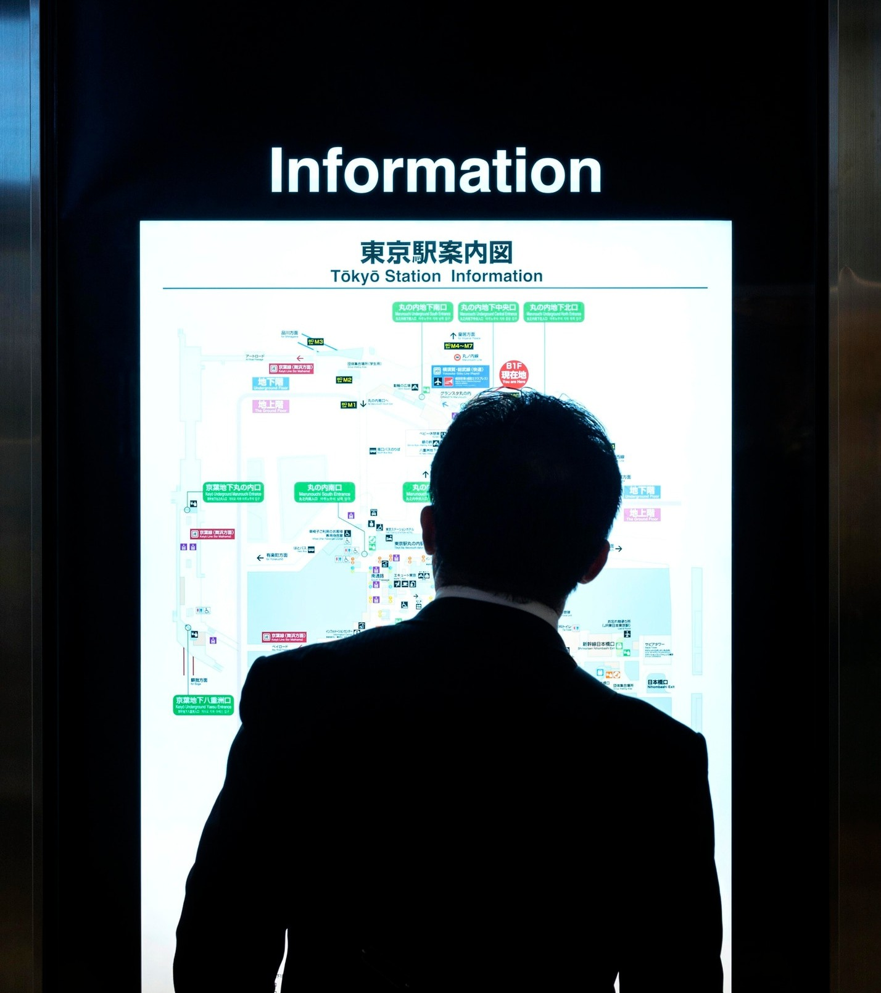



Multi-Factor Authentication (MFA)
MFA adds an extra layer of security by requiring multiple forms of . This makes it harder for attackers to gain unauthorized access to
and data.

Slide 11




Incident Response Planning
Developing a robust crucial for
plan is the impact of successful
phishing attacks. This plan should include
strategies and procedures.

Slide 12





Continuous Monitoring and Adaptation
Regularly and
defense mechanisms is essential in the ever-evolving landscape of phishing
attacks. Organizations must stay and adapt to new .

Slide 13






Conclusion
Defending against phishing attacks requires a
approach that combines
. By staying
,
and
, and
,
organizations can effectively mitigate the risks associated with phishing.

Slide 14
Thanks!
Created By : Navjot Singh

